Slide 1

Nested Interrupt Vector Controller
Lecture 3
Introduction to ARM Processor
This material is developed by IMTSchool for educational use only
All copyrights are reserved

Slide 2

Definition of Exception
Exceptions are events which are generated asynchronously either from inside the core itself or from the external peripherals. In general any even that disturb the normal behavior of the processor is an exception.
Interrupts are used with exceptions from the external peripherals. In other words interrupt is nothing but an exception external to the processor core.
ARM Cortex M3/M4 Supports 255 exceptions
15 System Exception
240 Interrupts

Slide 3
Nested Vectored Interrupt Controller
The Nested Vectored Interrupt Controller NVIC is an integrated part of the Cortex M3/M4 processor. It is closely linked to the CPU core logic and Its control registers are accessible as memory mapped. It provides the following features:
    Nested interrupt support
    Vectored interrupt support
    Dynamic priority changes support
    Reduction of interrupt latency
    Interrupt masking
The NVIC controls the interrupts as well as the system exceptions. The NVIC can be accessed in the System Control Space (SCS) address range, which is memory location 0xE000E000. Most of the interrupt control/status registers are accessible only in privileged mode, except the Software Trigger Interrupt register (STIR), which can be set up to be accessible in user mode.

Slide 4
Nested Vectored Interrupt Controller
SysTick Timer
Processor Core
Peripherals
NMI
NVIC
System Exceptions
IRQn
Cortex M3/M4 Processor

Slide 5
Interrupt Configuration
Each interrupt has a set of basic configurations through NVIC which are:
    Enable
    Clear Enable
    Set Pending
    Clear Pending
    Active status
    Priority level
. . . PRI0`
. . . IABR0
. . . CLRPEND0
. . . SETPEND0
. . . ICER0
. . . ISER0
0xE000E400
0xE000E300
0xE000E280
0xE000E200
0xE000E180
0xE000E100

Slide 6
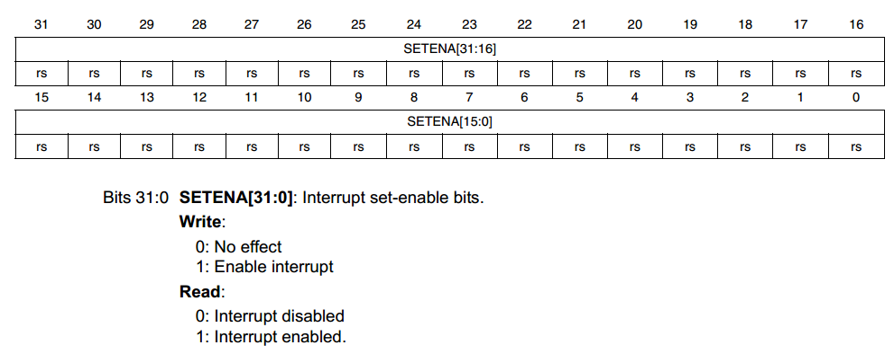
Enable Interrupt Register
Note
If a pending interrupt is enabled, the NVIC activates the interrupt based on its priority. If an interrupt is not enabled, asserting its interrupt signal changes the interrupt state to pending, but the NVIC never activates the interrupt, regardless of its priority.

Slide 7
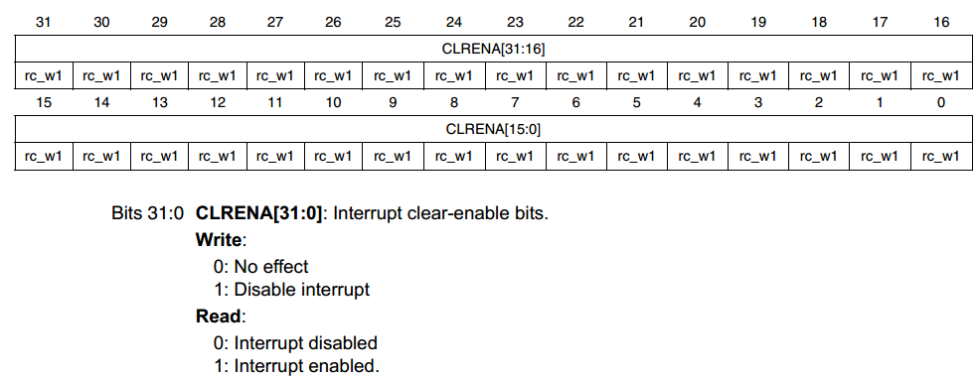
Enable Clear Enable Register
Note
Writing 1 to an ICPR bit does not affect the active state of the corresponding interrupt.

Slide 8
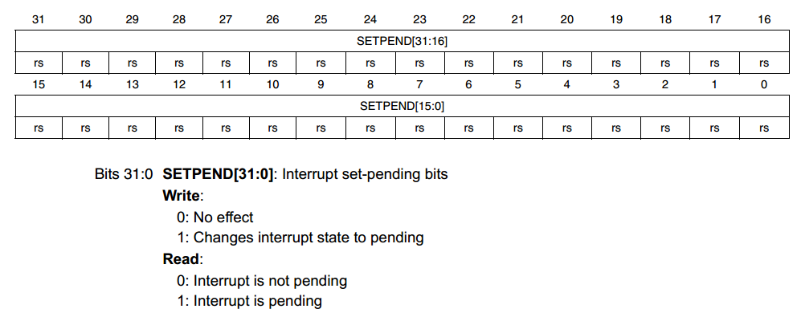
Set Pending Register
Note
Writing 1 to the ISPR bit corresponding to an interrupt that is pending:
  – has no effect.
Writing 1 to the ISPR bit corresponding to a disabled interrupt:
  – sets the state of that interrupt to pending.

Slide 9
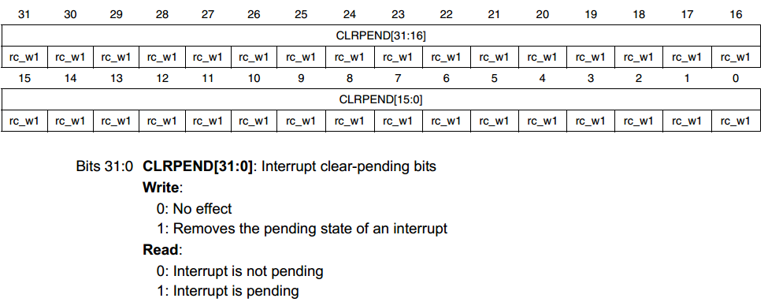
Clear Pending Register
Note
A bit reads as 1 if the status of the corresponding interrupt is active or active and pending.

Slide 10
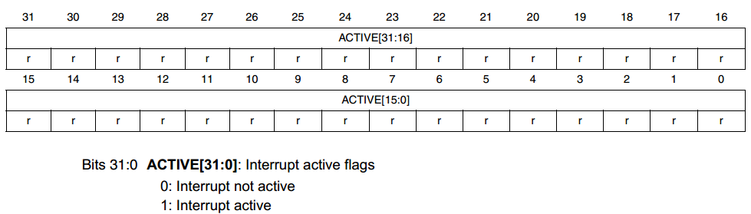
Interrupt Active Bit Register
Note
A bit reads as 1 if the status of the corresponding interrupt is active or active and pending.

Slide 11
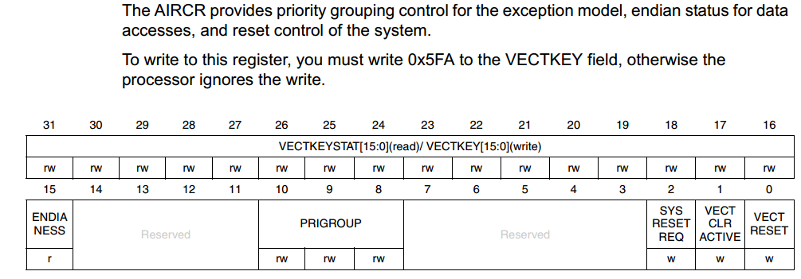
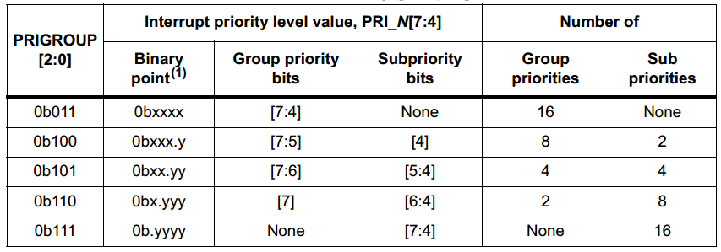
Interrupt Priority
1- Define Number of Groups and Number of Sub Priorities

Slide 12
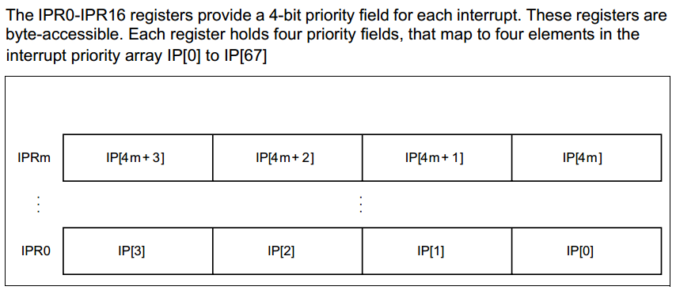
Interrupt Priority
1- Assign a priority for each interrupt

Slide 13
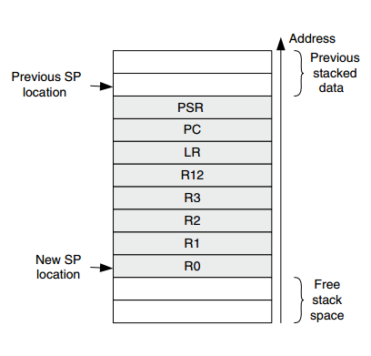
Stacking and Unstacking

Slide 14
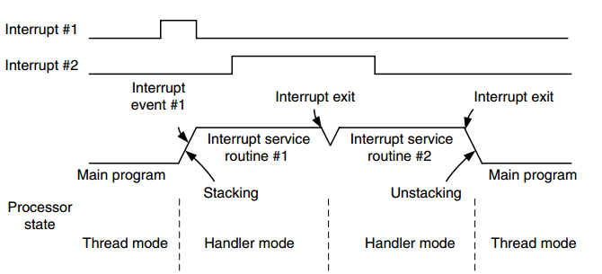
TAIL-CHAINING

Slide 15
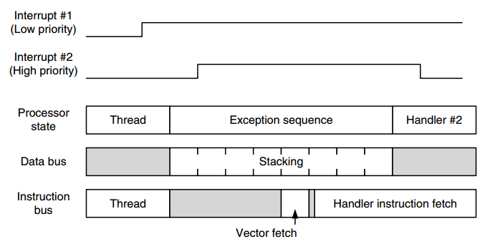
LATE ARRIVALS

Slide 16
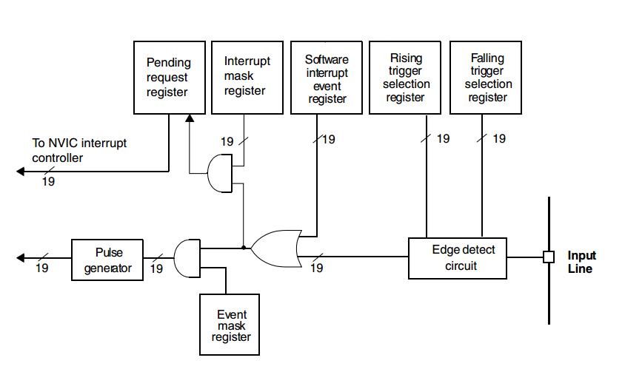
External Interrupt Controller

Slide 17


www.imtschool.com
ww.facebook.com/imaketechnologyschool/
This material is developed by IMTSchool for educational use only
All copyrights are reserved

